Slide 1

C Programming Introduction
Week 3:Standard output introduction
Lecturers : Cao Tuan Dung
Dept of Software Engineering
Hanoi University of Technology
For HEDSPI Project

Slide 2
Topic of this week
Output
  Class Lecture Review
    Presentation of results
    printf
    Streams
      puts, putchar (in <stdio.h>)
  Programming Exercises

Slide 3
Input/Output in C
C has no built-in statements for input or output.
A library of functions is supplied to perform these operations. The I/O library functions are listed the “header” file <stdio.h>.
You do not need to memorize them, just be familiar with them.

Slide 4
Streams
Streams
  Sequences of characters organized into lines
    ends with new line character
    ANSI C must support lines of at least 254 characters
  Performs all input and output
  Can often be redirected
    Standard input - keyboard
    Standard output - screen
    Standard error - screen

Slide 5
Formatting Output with printf
printf
  precise output formatting
    Conversion specifications: flags, field widths, precisions, etc.
  Can perform rounding, aligning columns, right/left justification, inserting literal characters, exponential format, hexadecimal format, and fixed width and precision
Format
  printf( format-control-string, other-arguments );
  format control string: includes a listing of the data types of the variables to be output and, optionally, some text and control character(s).
  other-arguments: correspond to each conversion specification in format-control-string
    each specification begins with a percent sign, ends with conversion specifier

Slide 6
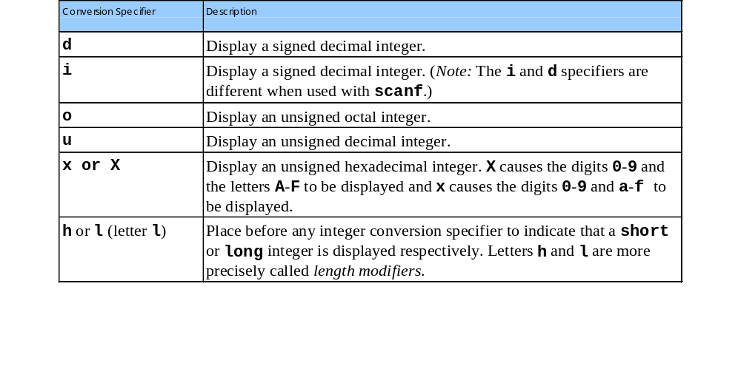
Printing Integers
Integer
  Whole number (no decimal point): 25, 0, -9
  Positive, negative, or zero
  Only minus sign prints by default (later we shall change this)

Slide 7
Example 1
1 #include <stdio.h>
2
3 int main()
4 {
5 printf( "%d\n", 455 );
6 printf( "%i\n", 455 );/*i same as d*/
7 printf( "%d\n", +455 );
8 printf( "%d\n", -455 );
9 printf( "%hd\n", 32000 );
10 printf( "%ld\n", 2000000000 );
11 printf( "%o\n", 455 );
455
455
455
-455
32000
2000000000
707
455
65081
1c7
1C7
12 printf( "%u\n", 455 );
13 printf( "%u\n", -455 );
14 printf( "%x\n", 455 );
15 printf( "%X\n", 455 );
16
17 return 0;
18 }

Slide 8
Printing Floating-Point Numbers
Floating Point Numbers
  Have a decimal point (33.5)
  Exponential notation (computer's version of scientific notation)
    150.3 is 1.503 x 10² in scientific
    150.3 is 1.503E+02 in exponential (E stands for exponent)
    use e or E
  f - print floating point with at least one digit to left of decimal
  g (or G) - prints in f or e(E) with no trailing zeros (1.2300 becomes 1.23)
    Use exponential if exponent less than -4, or greater than or equal to precision (6 digits by default)

Slide 9
Example 2
1 #include <stdio.h>
2
3 int main()
4 {
5 printf( "%e\n", 1234567.89 );
6 printf( "%e\n", +1234567.89 );
7 printf( "%e\n", -1234567.89 );
8 printf( "%E\n", 1234567.89 );
9 printf( "%f\n", 1234567.89 );
10 printf( "%g\n", 1234567.89 );
11 printf( "%G\n", 1234567.89 );
12
13 return 0;
14 }
1.234568e+006
1.234568e+006
-1.234568e+006
1.234568E+006
1234567.890000
1.23457e+006
1.23457E+006

Slide 10
Printing Strings and Characters
c
  Prints char argument
  Cannot be used to print the first character of a string
s
  Requires a pointer to char as an argument
  Prints characters until NULL ('\0') encountered
  Cannot print a char argument
Remember
  Single quotes for character constants ('z')
  Double quotes for strings "z" (which actually contains two characters, 'z' and '\0')

Slide 11
Example 3
1 #include <stdio.h>
2
3 int main()
4 {
5 char character = 'A';
6 char string[] = "This is a string";
7 const char *stringPtr = "This is also a string";
8
9 printf( "%c\n", character );
10 printf( "%s\n", "This is a string" );
11 printf( "%s\n", string );
12 printf( "%s\n", stringPtr );
13
14 return 0;
15 }
A
This is a string
This is a string
This is also a string

Slide 12
Other Conversion Specifiers
p
  Displays pointer value (address)
n
  Stores number of characters already output by current printf statement
  Takes a pointer to an integer as an argument
  Nothing printed by a %n specification
  Every printf call returns a value
    Number of characters output
    Negative number if error occurs
%
  Prints a percent sign
  %%

Slide 13
Example 4
1 #include <stdio.h>
2
3 int main()
4 {
5 int *ptr;
6 int x = 12345, y;
7
8 ptr = &x;
9 printf( "The value of ptr is %p\n", ptr );
10 printf( "The address of x is %p\n\n", &x );
11
12 printf("Total characters printed on this line is:%n",&y );
13 printf( " %d\n\n", y );
14
15 y = printf( "This line has 28 characters\n" );
16 printf( "%d characters were printed\n\n", y );
17
18 printf( "Printing a %% in a format control string\n" );
19
The value of ptr is 0065FDF0
The address of x is 0065FDF0
Total characters printed on this line is: 41
This line has 28 characters
28 characters were printed
Printing a % in a format control string
20 return 0;
21 }

Slide 14
Printing with Field Widths and Precisions
Field width
  Size of field in which data is printed
  If width larger than data, default right justified
    If field width too small, increases to fit data
    Minus sign uses one character position in field
  Integer width inserted between % and conversion specifier
  %4d - field width of 4

Slide 15
Printing with Field Widths and Precisions (II)
Precision
  Meaning varies depending on data type
  Integers (default 1) - minimum number of digits to print
    If data too small, prefixed with zeros
  Floating point - number of digits to appear after decimal (e and f)
    For g - maximum number of significant digits
  Strings - maximum number of characters to be written from string

Slide 16
Printing with Field Widths and Precisions (III)
Format
  Precision: use a dot (.) then precision number after %
  %.3f
  Can be combined with field width
  %5.3f
  Can use integer expressions to determine field width and precision
    Use *
    Negative field width - left justified
    Positive field width - right justified
    Precision must be positive
    printf( "%*.*f", 7, 2, 98.736 );

Slide 17
Example 5
1 #include <stdio.h>
2
3 int main()
4 {
5 int i = 873;
6 double f = 123.94536;
7 char s[] = "Happy Birthday";
8
9 printf( "Using precision for integers\n" );
10 printf( "\t%.4d\n\t%.9d\n\n", i, i );
11 printf( "Using precision for floating-point numbers\n" );
12 printf( "\t%.3f\n\t%.3e\n\t%.3g\n\n", f, f, f );
13 printf( "Using precision for strings\n" );
14 printf( "\t%.11s\n", s );
15
16 return 0;
17 }
Using precision for integers
0873
000000873
Using precision for floating-point numbers
123.945
1.239e+02
124
Using precision for strings
Happy Birth

Slide 18
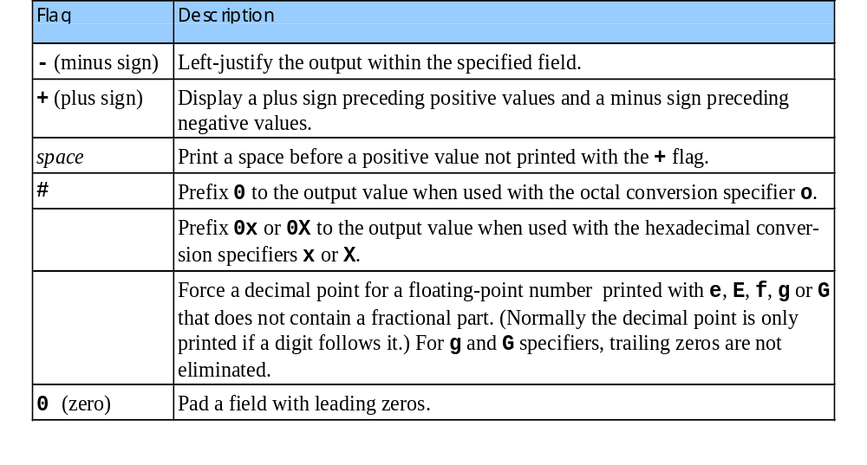
Using Flags in the printf Format-Control String
Flags
  Supplement formatting capabilities
  Place flag immediately to the right of percent sign
  Several flags may be combined

Slide 19
Example 6
1 #include <stdio.h>
2
3 int main()
4 {
5 printf( "%10s%10d%10c%10f\n\n", "hello", 7, 'a', 1.23 );
6 printf( "%-10s%-10d%-10c%-10f\n", "hello", 7, 'a', 1.23 );
7 return 0;
8 }
hello 7 a 1.230000
hello 7 a 1.230000

Slide 20
Example 7
1 #include <stdio.h>
2
3 int main()
4 {
5 int c = 1427;
6 double p = 1427.0;
7
8 printf( "%#o\n", c );
9 printf( "%#x\n", c );
10 printf( "%#X\n", c );
11 printf( "\n%g\n", p );
12 printf( "%#g\n", p );
13
14 return 0;
15 }
02623
0x593
0X593
1427
1427.00

Slide 21
Printing Literals and Escape Sequences
Printing Literals
  Most characters can be printed
  Certain "problem" characters, such as the quotation mark "
  Must be represented by escape sequences
    Represented by a backslash \ followed by an escape character

Slide 22
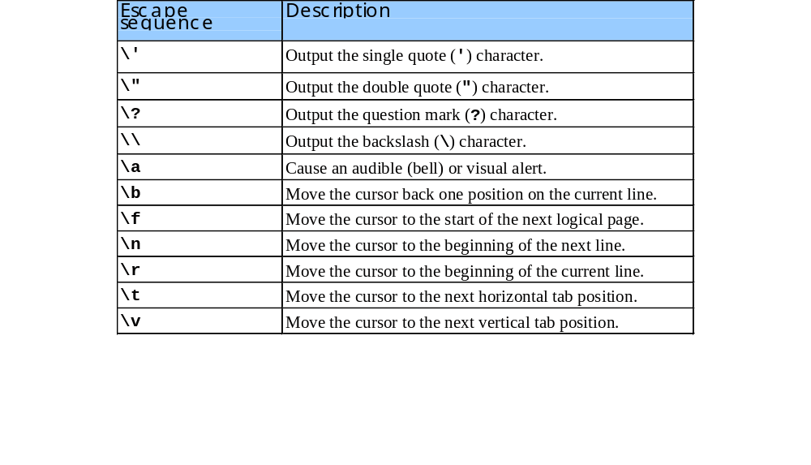
Printing Literals and Escape Sequences (II)

Slide 23
Exercises 3.1
Write a program that shows the size of basic data types, such as: int, long short, double, char…
You can use sizeof function to perform this task.
e.g: sizeof(int);

Slide 24
Solution
#include <stdio.h>
main()
{
printf(" THE SIZE OF BASIC DATA TYPES\n\n");
printf("int %d\n",sizeof(int));
printf("short int %d\n",sizeof(short int));
printf("long int %d\n",sizeof(long int));
printf("unsigned int %d\n",sizeof(unsigned int));
printf("unsigned short %d\n",sizeof(unsigned short));
printf("unsigned long %d\n",sizeof(unsigned long));
}

Slide 25
Exercises 3.2
Write the following program. Compile, link and run it.
#include<stdio.h>
void main ()
{
int year;
float height;
year = 21;
height = 1.77;
printf("Ali is %d years old and %f meter height\n", year, height);
}

Slide 26
Exercises 3.3
Write a program that asks your name and then greets you.
You can use scanf() function to read data with specified format from keyboard.
E.g:
  char word[20];
  scanf("%19s", word);

Slide 27
Solution
#include <stdio.h>
int main(void) {
char name[16]; /* string to hold name */
printf("What's your name? ");
scanf("%15s", name);
printf("Hi there, %s!\n", name);
return 0;
}

Slide 28
Exercises 3.4
Now it's time for you to do some programming of your own. We want you to write a C program that will read in two integers n and m and print out the sum of all the values between n and m inclusive. The program should look like this when it's working:
  Enter first number: 3
  Enter second number: 5
  Sum 3+5 = 8

Slide 29
Solution
#include <stdio.h>
int main(void) {
int n, m; /* lower and upper bounds */
int sum; /* accumulated sum */
/*
* Get the numbers
*/
printf("Enter first number: ");
scanf("%d", &n);
printf("Enter second number: ");
scanf("%d", &m);

Slide 30
Solution
/*
* Compute sum of n and m
* (also, display inputs for user to check)
*/
sum = n+m;
/*
* Print results
*/
printf("Sum of %d and %d = %d\n", n, m, sum);
return 0;
}

Slide 31
Exercise 3.5
The BK library™ DVD shop has three rental rates
  Type of rent Rent per disk
  Overnight $7.00
  Three-day $5.00
  Weekly $3.00
Write a simple C program to input the day of the week, and the number of overnight, three-day and weekly DVDs the customer is renting. Compile this program, and print out the input values to ensure that they are read correctly.
Update your program to compute the total cost of renting the DVDs

Slide 32
Hint
Note: since the day of the week is indicated by a single character, you will need to define a set of characters, e.g., ‘m’ for Monday, ‘t’ for Tuesday, and ‘h’ for Thursday.
When reading a single character, use scanf(“ %c”,&day) to skip leading blanks.

